Slide 1
TEST RESULT IMPROVE TPP
PT CITRA NIAGA

Slide 2
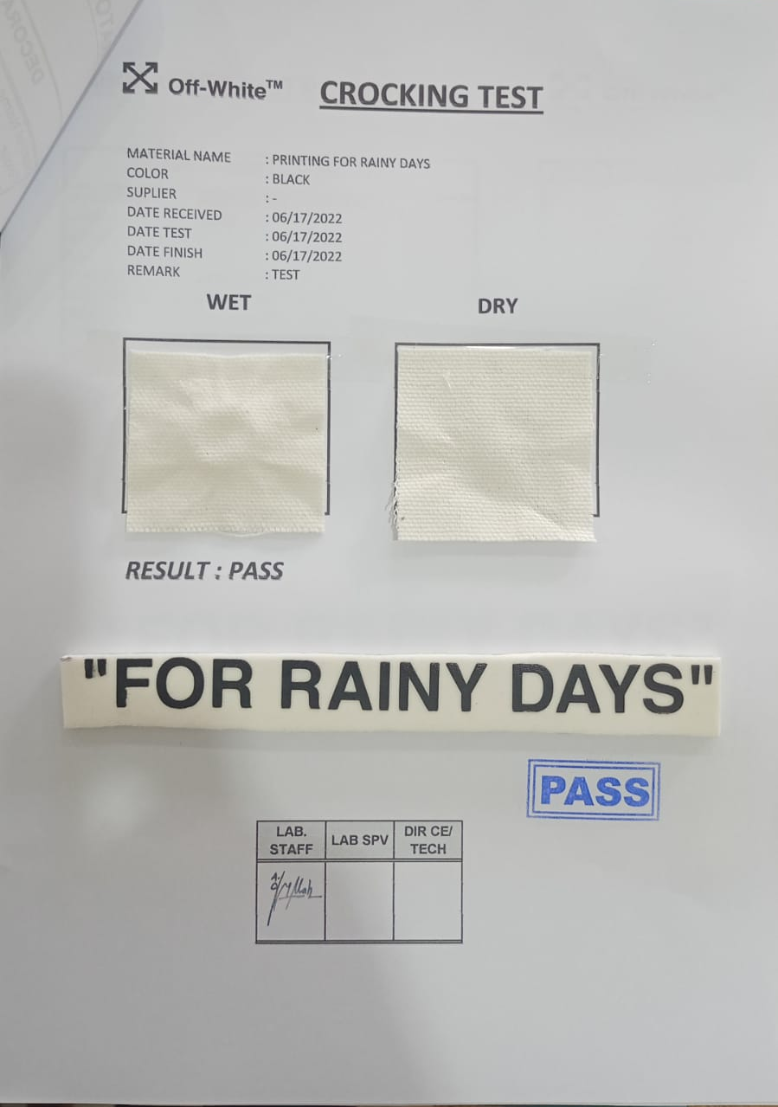
IMPROVE PROCESS:

Slide 3
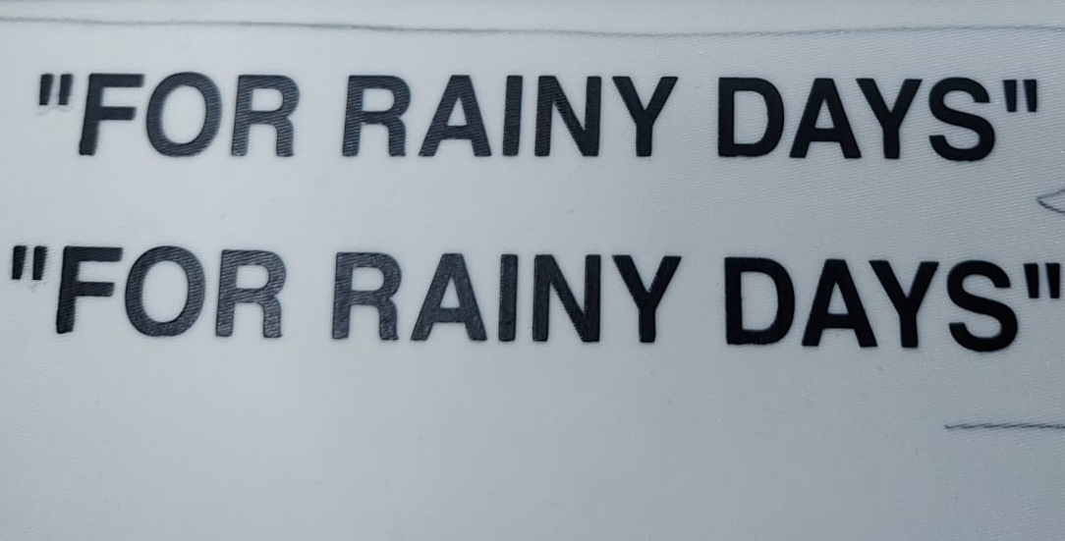
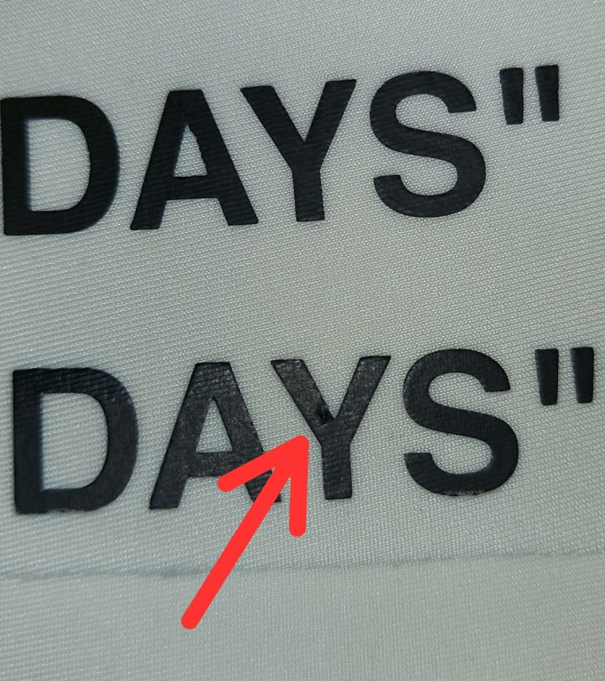
BLACK PRINTING QUALITY ISSUE:
Printing have 4-6 scratching
The Glue Replace U Bond Glue

Slide 4
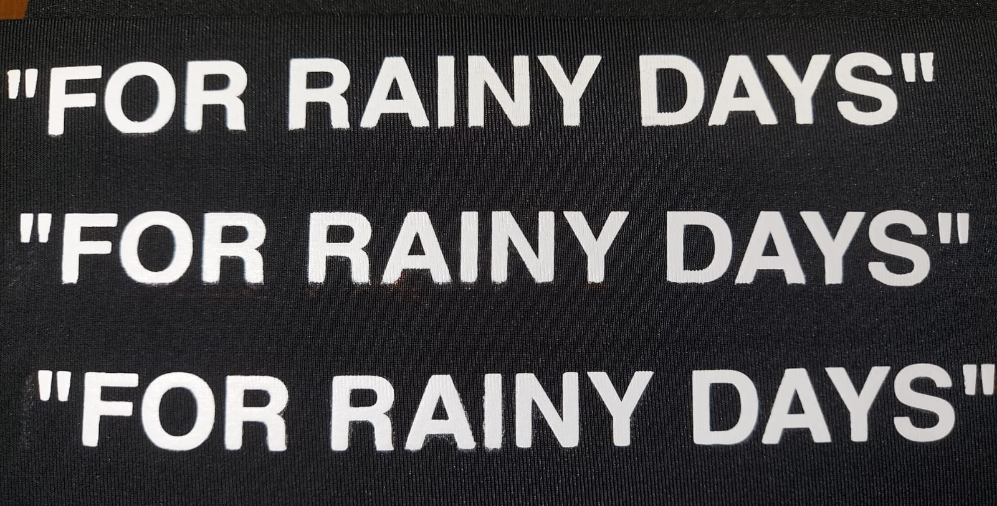
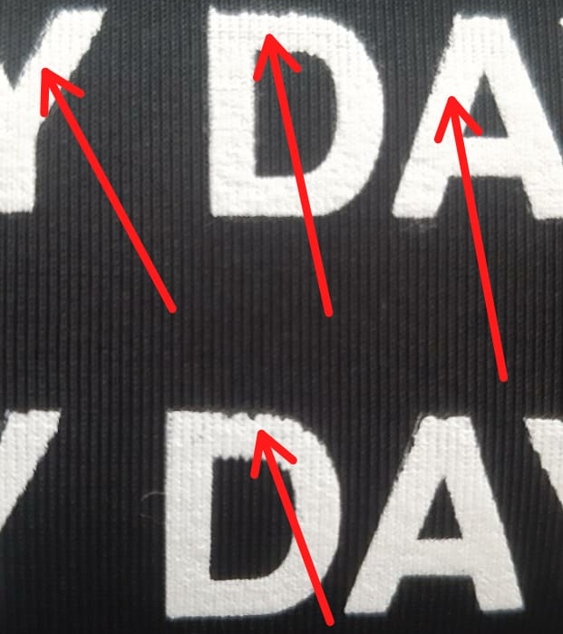
WHITE PRINTING QUALITY ISSUE:
Printing have 4-6 scratching
The Glue Replace U Bond Glue

Slide 5
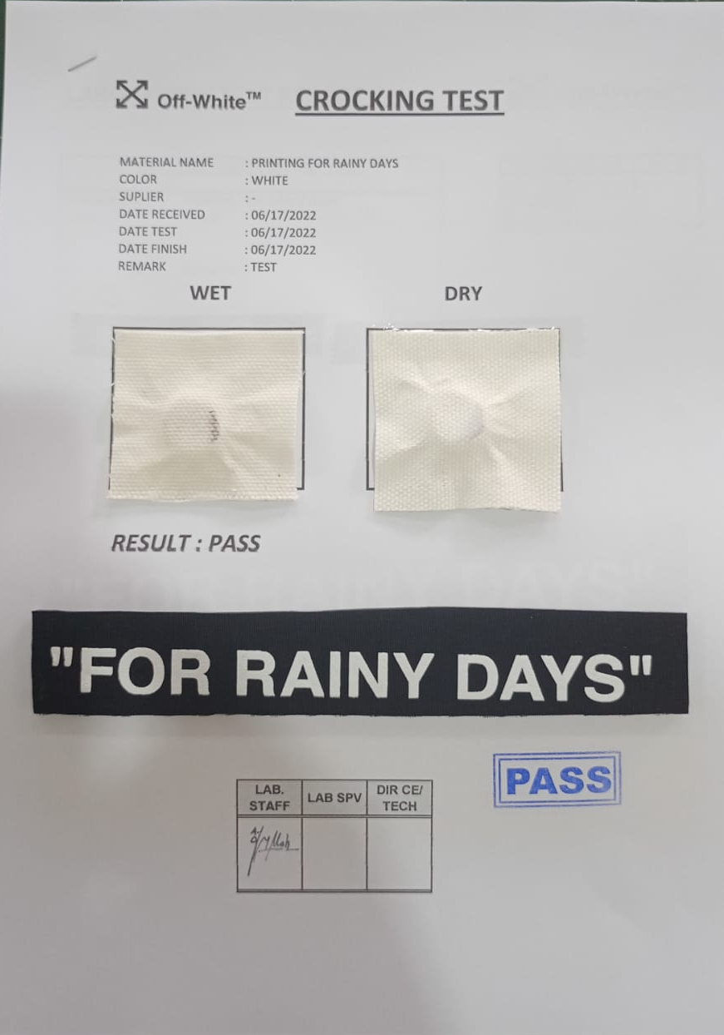
SAMPLE LAB TES BLACK PRINTING:

Slide 6
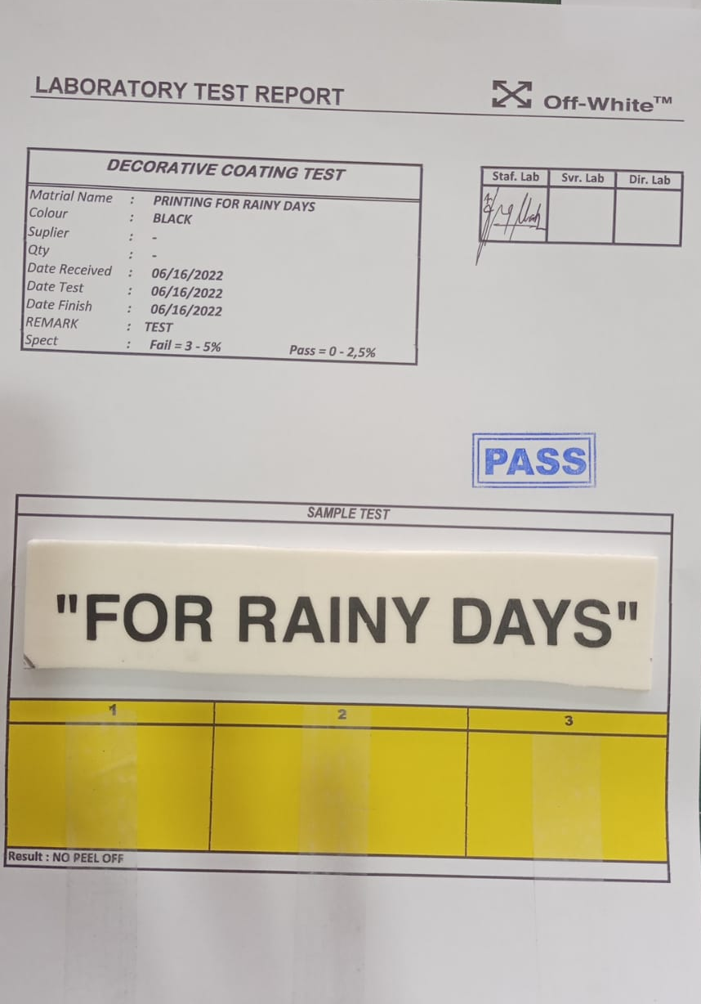
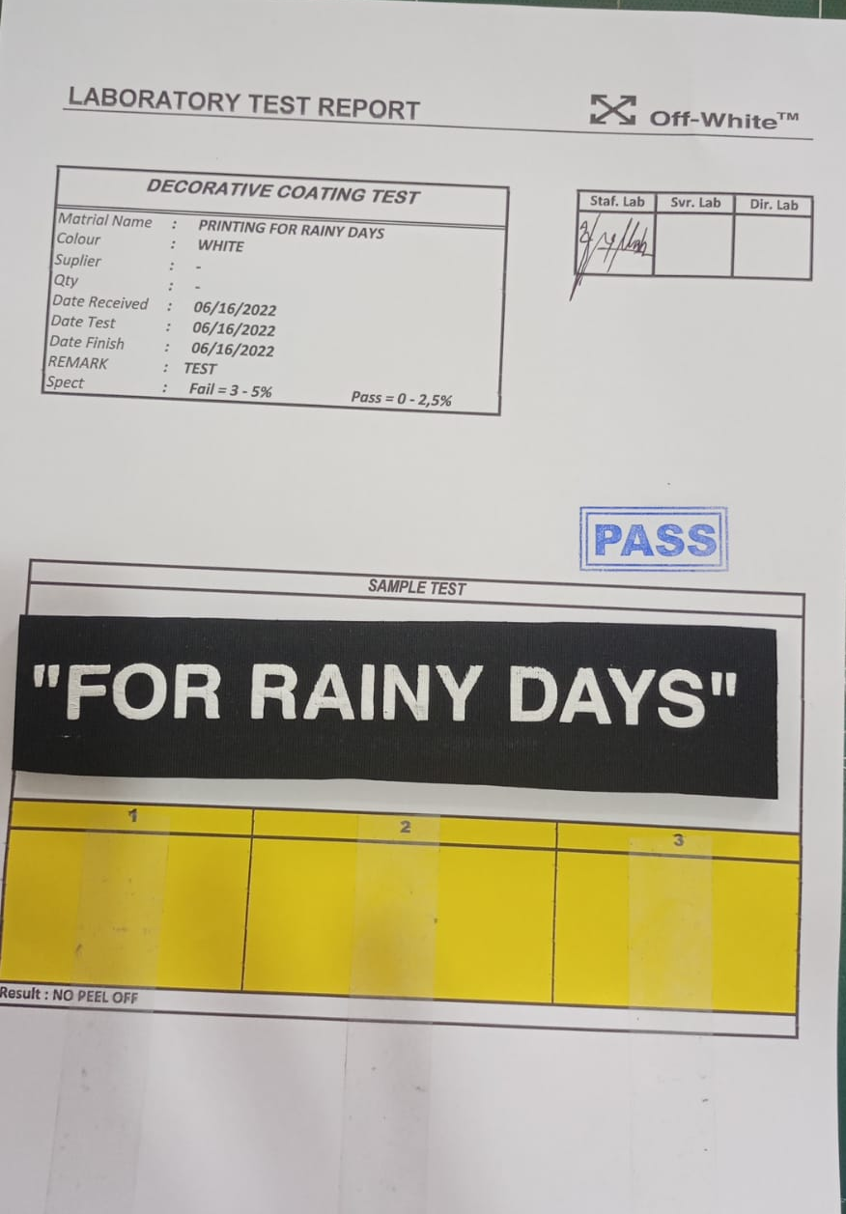
SAMPLE LAB TEST:

Slide 7
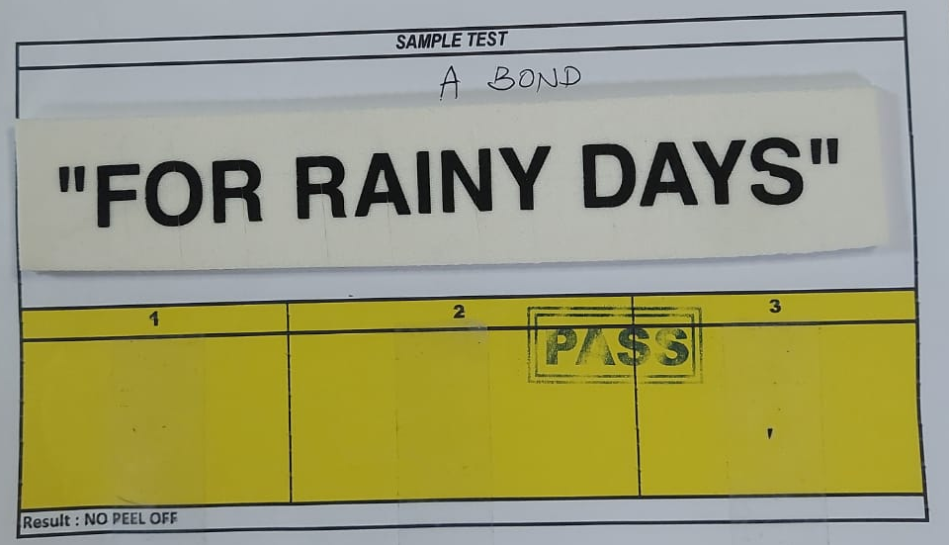
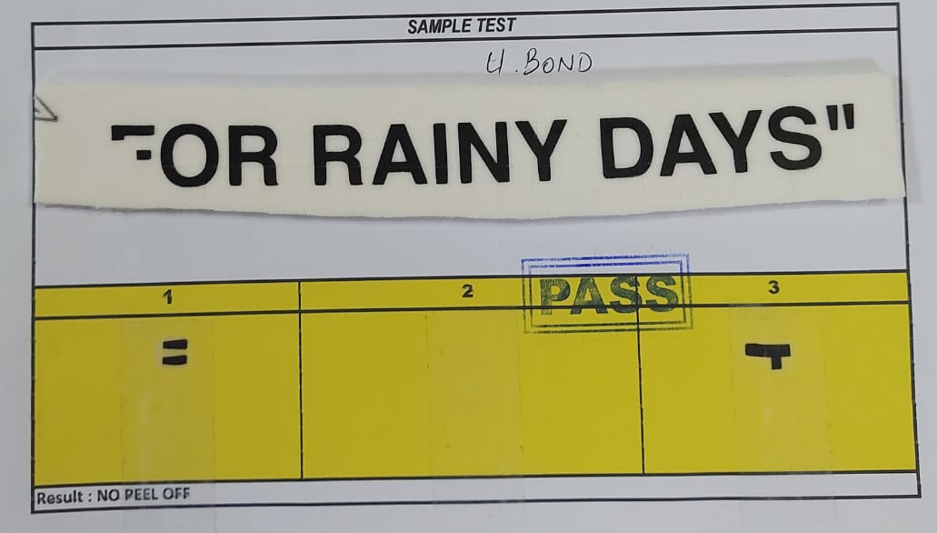
SAMPLE LAB TEST BLACK PRINTING:
A Bond Glue
U Bond Glue

